Slide 1
Discussion on Dot Net Framework & Common controls overview
What and Why .NET
Net Framework and Architecture
Common Language Runtime
Managed Code
Some Common Controls

Slide 2
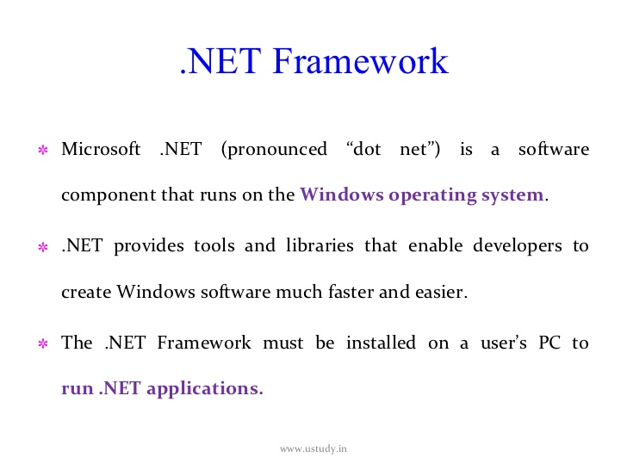
It is s/w frame work support language inoperability

Slide 3
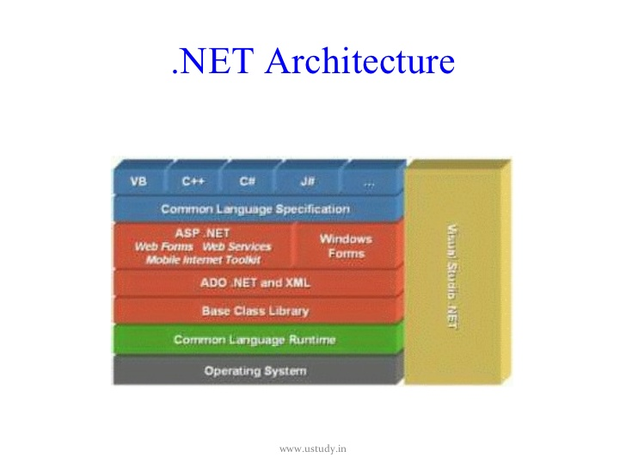

Slide 4
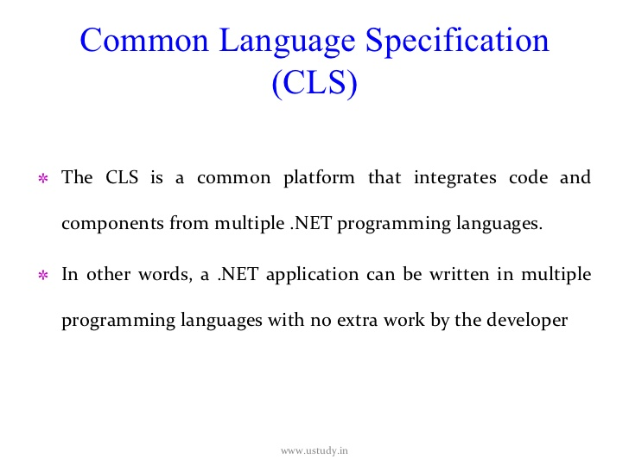

Slide 5
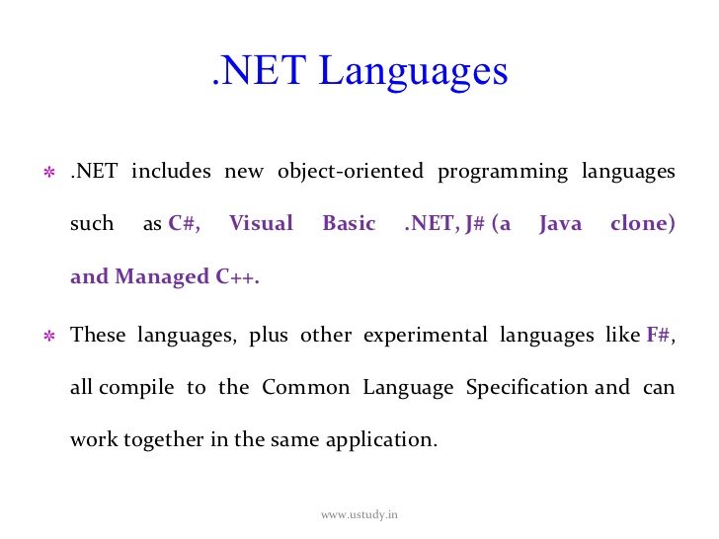

Slide 6
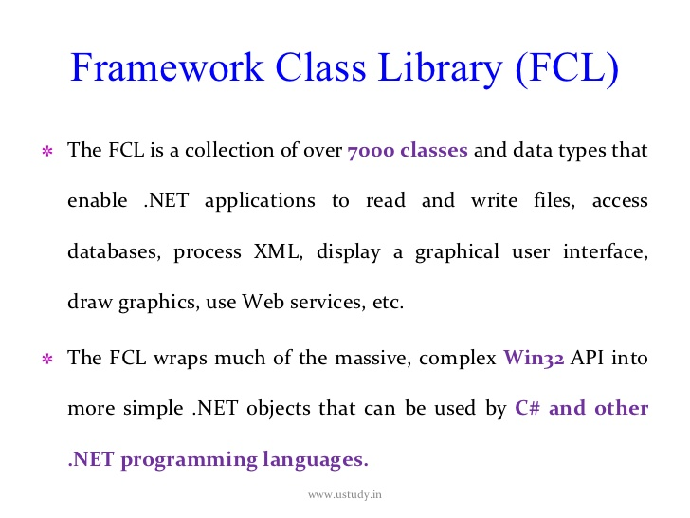

Slide 7
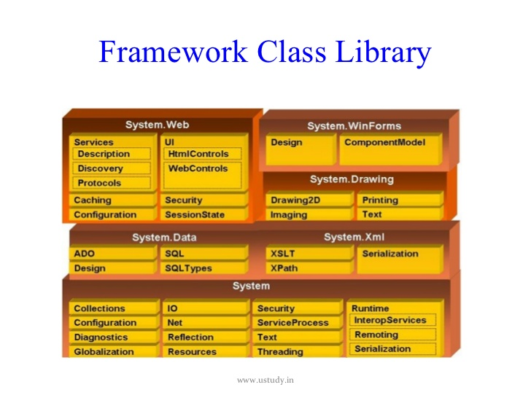

Slide 8
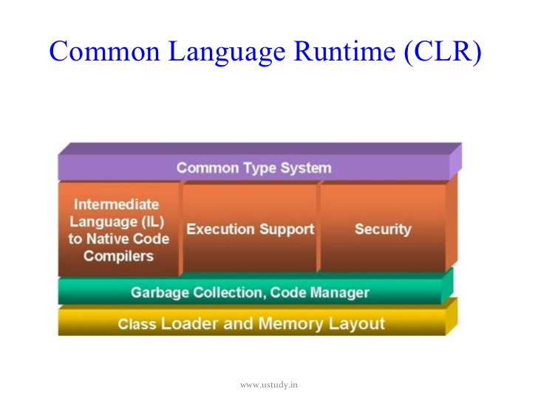

Slide 9
The Common Language Runtime (CLR) is an Execution Environment . It works as a layer between Operating Systems and the applications written in .Net languages that conforms to the Common Language Specification (CLS). The main function of Common Language Runtime (CLR) is to convert the Managed Code into native code and then execute the Program. The Managed Code compiled only when it needed, that is it converts the appropriate instructions when each function is called . The Common Language Runtime (CLR) 's Just In Time (JIT) compilation converts Intermediate Language (MSIL) to native code on demand at application run time.
During the execution of the program ,the Common Language Runtime (CLR) manages memory, Thread execution, Garbage Collection (GC) ,Exception Handling, Common Type System (CTS), code safety verifications, and other system services. The CLR ( Common Language Runtime ) defines the Common Type System (CTS), which is a standard type system used by all .Net languages . That means all .NET programming languages uses the same representation for common Data Types , so Common Language Runtime (CLR) is a language-independent runtime environment . The Common Language Runtime (CLR) environment is also referred to as a managed environment, because during the execution of a program it also controls the interaction with the Operating System. In the coming section you can see what are the main functions of Common Language Runtime (CLR).

Slide 10
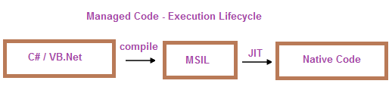
Managed and Unmanaged code

Slide 11
Code that is executed by the CLR.
Code that targets the common language runtime, the foundation of the .NET Framework, is known as managed code.
Managed code supplies the metadata necessary for the CLR to provide services such as memory management, cross-language integration, code access security, and automatic lifetime control of objects. All code based on IL executes as managed code.
Code that executes under the CLI execution environment.

